Slide 1

Customer lifetime value analysis
Of an Auto Insurance Market

Slide 2

OBJECTIVE
This is an insurance company data from which we need to make a regression model to get predictions of the dependent variable Customer Lifetime Value. This is done to get a prediction about the customers who are more profitable to the company and the factors affecting it.
Considering the given objective, we are running a Linear Regression Model on the dependent variable Customer Lifetime Value to analyse the influence of various independent variables on the Customer Lifetime Value.
This Photo by Unknown Author is licensed under CC BY-NC

Slide 3


DEPENDENT VARIABLE
The dependent variable in this dataset is the Customer Lifetime Value. The customer lifetime value is the total revenue that the customer would generate for the insurance company throughout the period of being a customer. A higher customer lifetime value shows that the customer is more profitable for the company and efforts should be made to hold on to them.

Slide 4
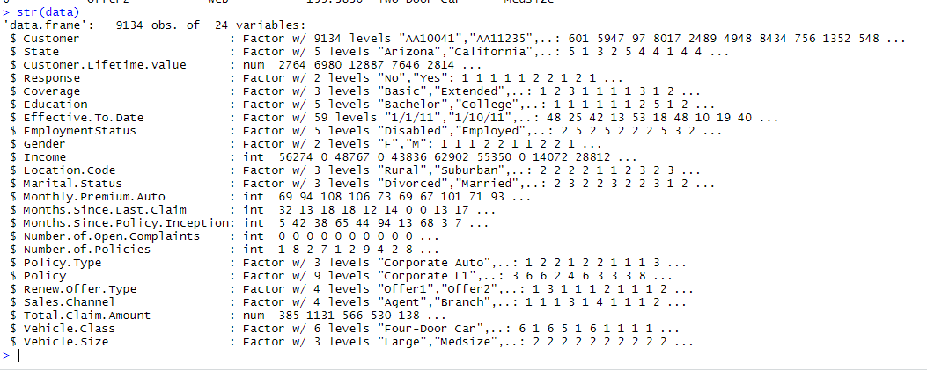
COUNT OF VARIABLES AND OBSERVATIONS
There are 24 variables in the given data set and it contains 9134 observations.
The Variables are:

Slide 5

SIGNIFICANT VARIABLES
After running the Linear Regression Model, we find that all the variables aren’t affecting the Customer Lifetime Value.
Significant variables are the ones that have an impact on the Customer Lifetime Value.
The significant variables are found by checking the p-values obtained in the model. The ones with a p-value<0.05 are considered to be significant.
The variables are: Coverage, Education, Employment Status=(“ Employed”, “Retired”, “Unemployed”), Gender, Marital Status, Monthly Premium Auto, Number of Open Complaints=(“2”, “3”, “4”, “5”), Number of Policies, Total Claim Amount and Vehicle Class=( “Luxury Car”, “Sports Car”, “SUV”)

Slide 6
INSIGNIFICANT VARIABLES
. The concept of forward, backward & best fit regression deals with omission of insignificant variables from the model.
The Insignificant variables in this model which do not have a relevant effect on the Customer Lifetime Value are:
Customer
State
Response
Effective to Date
Employment Status=(“ Disabled”, “ Medical Leave”)
Location Code
Months Since Last Claim
Months Since Policy Inception
Number of Open Complaints = “1”
Policy Type
Policy
Renew Offer Type
Sales Channel
Vehicle Class=(“ Luxury SUV”, “Two door car”
Vehicle Size

Slide 7
EXPLANATION OF SIGNIFICANT VARIABLES
The Significant variables are the variables that effect the dependent variable Customer Lifetime Value.
Let’s understand why these variables are significant and their relationship with the dependent variable.
Coverage: The type of coverage offered by the insurance company determines the Customer Lifetime Value of a particular customer as the coverage determines how much the customer needs to pay depending on his choice.
Education: The education of a customer is a factor that affects the CLV as people with a relevant education are likely to buy auto insurance as they understand its need and benefits.
Employment Status: The Employment status is one of the most important variables affecting the Customer Lifetime Value. Employed customers will generally tend to have higher CLV’s than Retired and Unemployed People. Whereas disabled people and ones on medical leave do not have a significant effect on the CLV.

Slide 8
Gender: The gender of a person is seen to be having an effect on the CLV. In reality, most of the buyers of auto insurance turn out to be male, according to statistics. So there is an impact of the CLV depending on the Gender.
Income: Undoubtedly one of the most important factors as it determines the capability of a customer to buy. Higher the income of a person, more are the chances of him having costlier cars whose insurance would also cost more thereby increasing the Customer Lifetime Value.
Marital Status: The Marital Status of a customer effects the CLV as well. People who are married are more likely to have cars or a higher number of cars resulting in them buying more insurance, thereby increasing the CLV.
Monthly Premium Auto: The monthly premium auto is the amount a customer pays monthly for the insurance. Therefore, higher the amount of the premium, higher will be the CLV.
Number of open complaints: The number of open complaints is a great indicator of how happy a customer is and what are his chances of continuing to buy from the company. Higher number of open complaints will reduce the Customer Lifetime Value as they will not be generally happy with the service and are likely to take their business elsewhere.

Slide 9
Number of policies: The number of policies a customer has obviously affects the Customer Lifetime Value as a higher number of policies would mean a higher CLV.
Total Claim Amount: The total claim amount a customer has got effects the CLV as well. A higher total claim amount may actually lead to a lower Customer Lifetime Value as the company needs to pay back a higher amount, thereby reducing the actual earnings.
Vehicle Class: The vehicle class is a significant variable that affects the Customer Lifetime Value. People with luxury cars or sports cars or expensive SUV’s would generally have to pay more for the insurance they are buying due to the benefits and privileges, which increases the CLV of such customers.

Slide 10

RESULTS OBTAINED
After running the Linear regression model and doing the necessary manipulations we get to see the significant variables that affect the Customer Lifetime Value.
Some important values and results are obtained from the model.
The R-square value is 0.9114 and the adjusted R-square value is 0.9111 which indicates that the model is robust and dependable.
The P value in BP Test values is less than 0.005 and therefore the assumption is rejected.
The P- value in the Anderson-Darling test is less than 0.005 and therefore the it is rejected.
The P-value in DWT test is 0.82 which is high and therefore the assumption is validated.
The MAPE or Mean Accurate Percentage Error value is 0.1096 which shows a significantly error, indicating the model to be robust.

Slide 11
Keeping all the factors in mind and the values obtained from various tests, we find that the Linear Regression Model is a robust one in this case giving us a good idea of how the variables are affecting the Customer Lifetime Value along with a positive or negative co-efficient showing the kind of impact they are most likely going to have. Studying it carefully can give us ideas and ways that the insurance company can implement to improve the CLV.

Slide 12

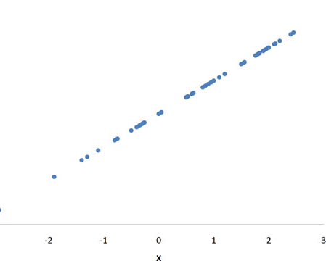
VARIABLE RELATIONSHIPS
Positive Variables : Coverage, Education, Employment Status= (“Employed”), Income, Marital Status =(“ Married”), Monthly Premium Auto, Number of Policies, Vehicle Class=(“ Luxury Car”, “Sports Car”, “SUV”)
This Photo by Unknown Author is licensed under CC BY-SA-NC

Slide 13
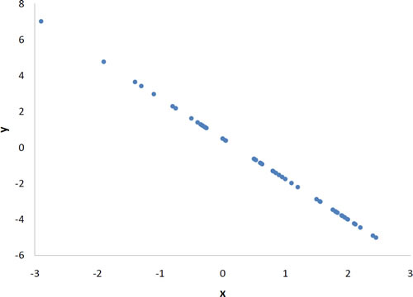
Negative Variables: The negative variables in the model are:
Employment Status= (“ Retired”, “ Unemployed”)
Gender
Marital Status= (“ Single”)
Number of Open Complaints= ( “2”, “3”, “4”, “5”)
Total Claim Amount
This Photo by Unknown Author is licensed under CC BY-SA-NC

Slide 14
BUSINESS RECOMMENDATIONS
In a general sense, it is good for the company to target customers who qualify for variables that have a Positive relation with the Customer Lifetime Value for a maximization problem. Targeting those customers and providing them more benefits and facilities can be a good way to increase the CLV. Efforts should be made to deal with the variables that have a negative relation with the CLV like number of open complaints. The company can try and address these complaints better and faster and eliminate them, thereby increasing the chances of a higher CLV.
In a minimization approach, the customers who qualify for variables with a Negative relation with the Customer Lifetime Value can be targeted.
However, focusing on the positive relations makes more sense in a general situation.

Slide 15

THANK YOU

